Slide 1
Self Driving Car Game
Capstone Project Warm-up Presentation:

Slide 2
Group Members
Bhaviya Chopra (TL)
Favour Eseagwu
Aswin Philip
Gagandeep Singh
Mohammedfaiq Shaikh

Slide 3
Table of Contents
Scope
Project Overview
Project Timeline

Slide 4
Scope
01
Create a visually appealing and immersive game environment.
02
Implement advanced AI algorithms for the self-driving car.
0
3
Option 3
Text goes here goes here goes here goes here goes here goes here goes here goes here goes here goes here goes here goes here goes here goes here
Design an intuitive and user-friendly interface that displays essential information.

Slide 5
Project Overview
Our goal is to develop an AI-powered Self Driving Game that is capable of sensing its environment and moving safely with little
or no human input .
Key Components:
User Profiling
Data Collection: Gather a comprehensive driving database.
Feature Extraction: Extract relevant features for analysis.
Machine Learning
Recommendation Generation
Feedback Loop
Continuous Learning

Slide 6
Project Timeline
Phase 1: Data Collection and Feature Extraction (Weeks 1-4)
Phase 5: Continuous Learning (Ongoing)
Phase 2: User Profiling (Weeks 5-8)
Timeline
Phase 4: Recommendation Generation and Feedback Loop (Weeks 13-16)
Phase 3: Machine Learning Model (Weeks 9-12)

Slide 7
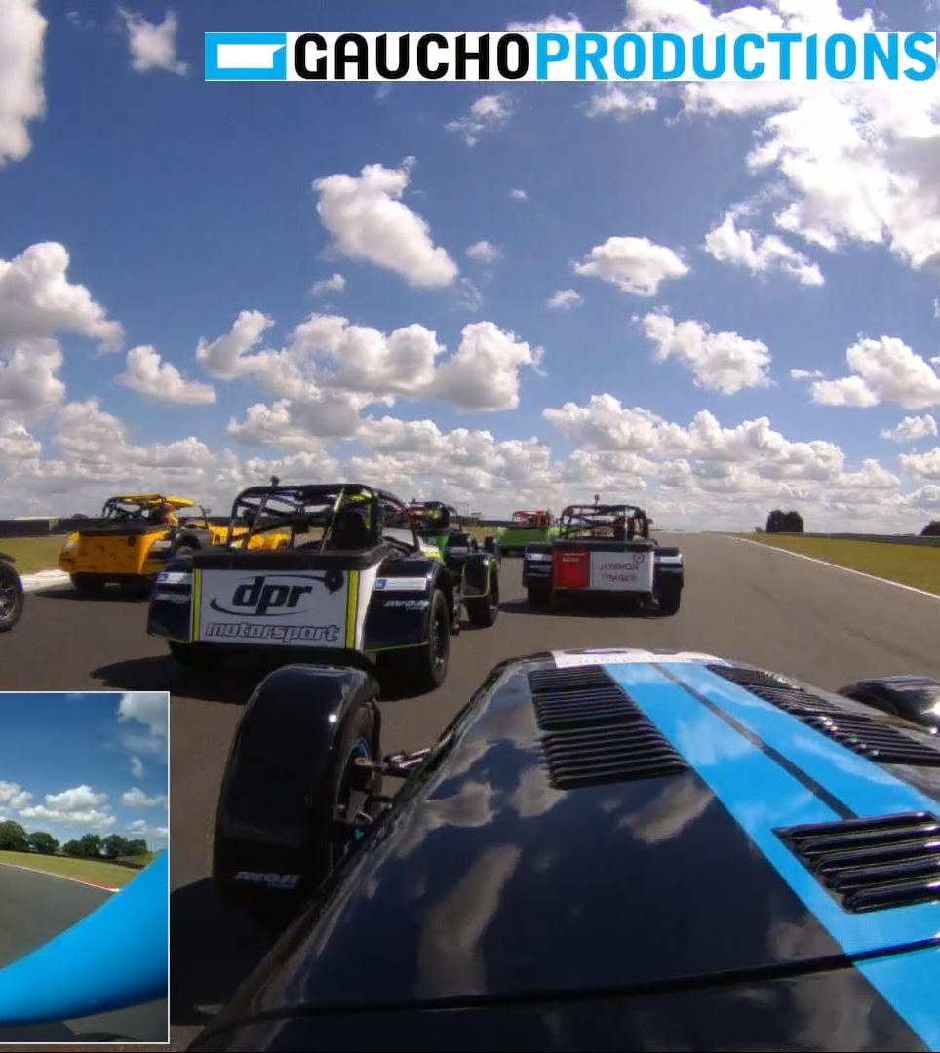
Conclusion
Aim to build a self driven game combine a variety of sensors to perceive their surroundings, such as radar, sonar, GPS, odometry and inertial measurement units to identify appropriate navigation paths, as well as obstacles and relevant signage.

Slide 8
Thank You

